Slide 1
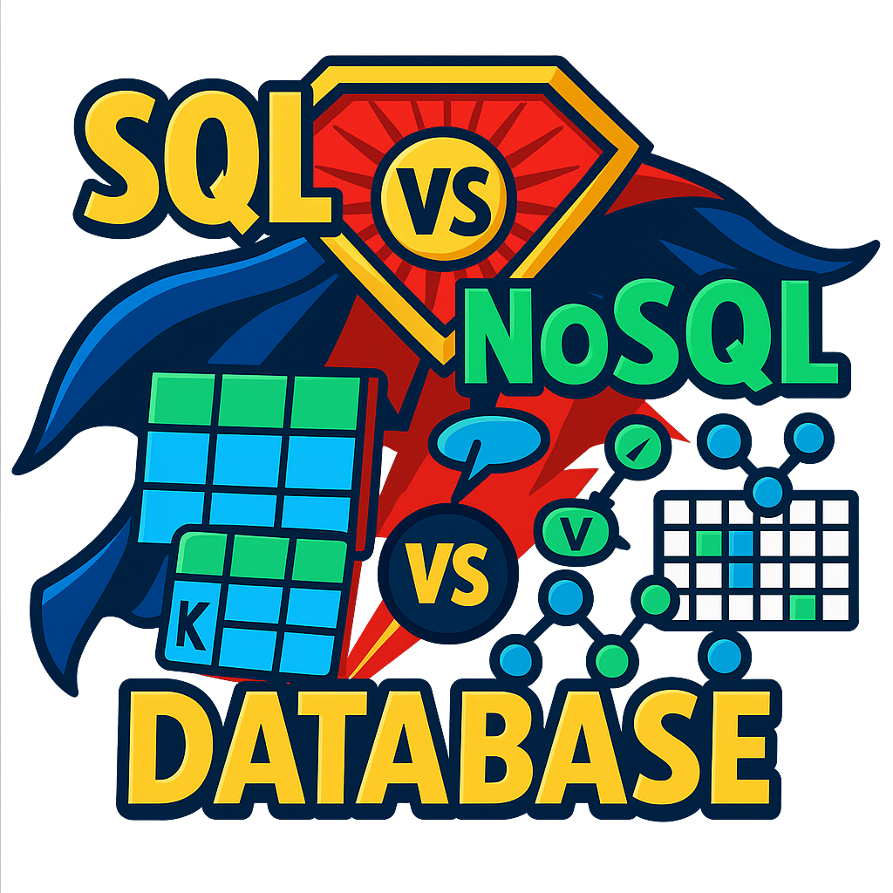
SQL VS NoSQL
One of the biggest decisions we make while designing a system is choosing between a relational (SQL) or non-relational (NoSQL) database.
Both have their strengths and use cases, but they differ significantly in their approach to data storage and retrieval.
Key differences between SQL and NoSQL databases to help you understand which might be best suited for your specific needs.
Data Model
Schema
Scalability
Query Language
Transaction Support
Performance
Use Cases

Slide 2
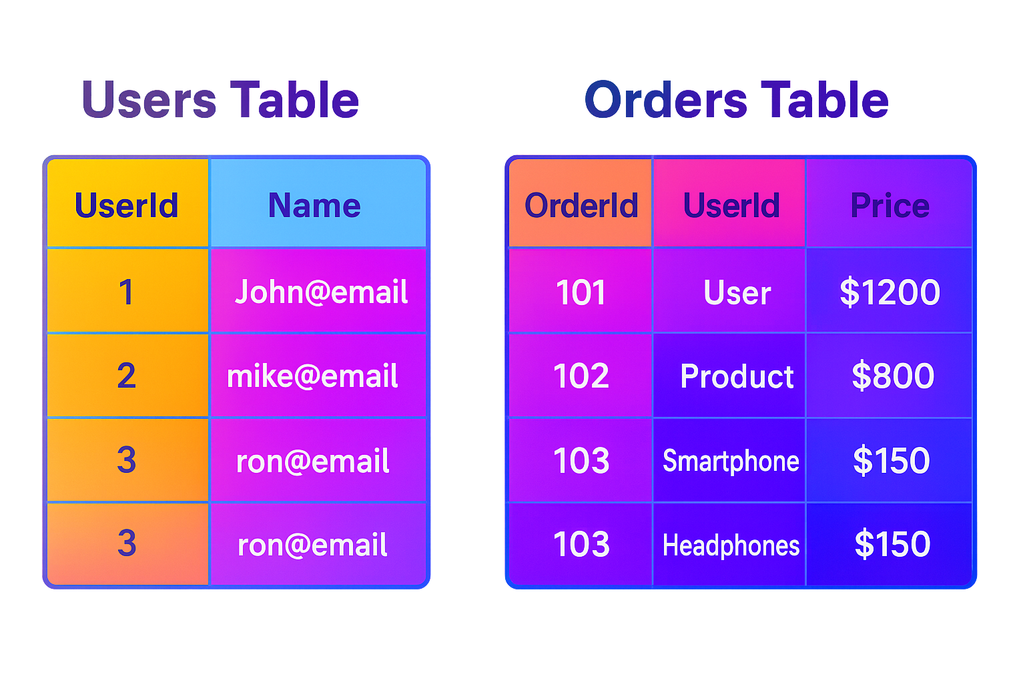
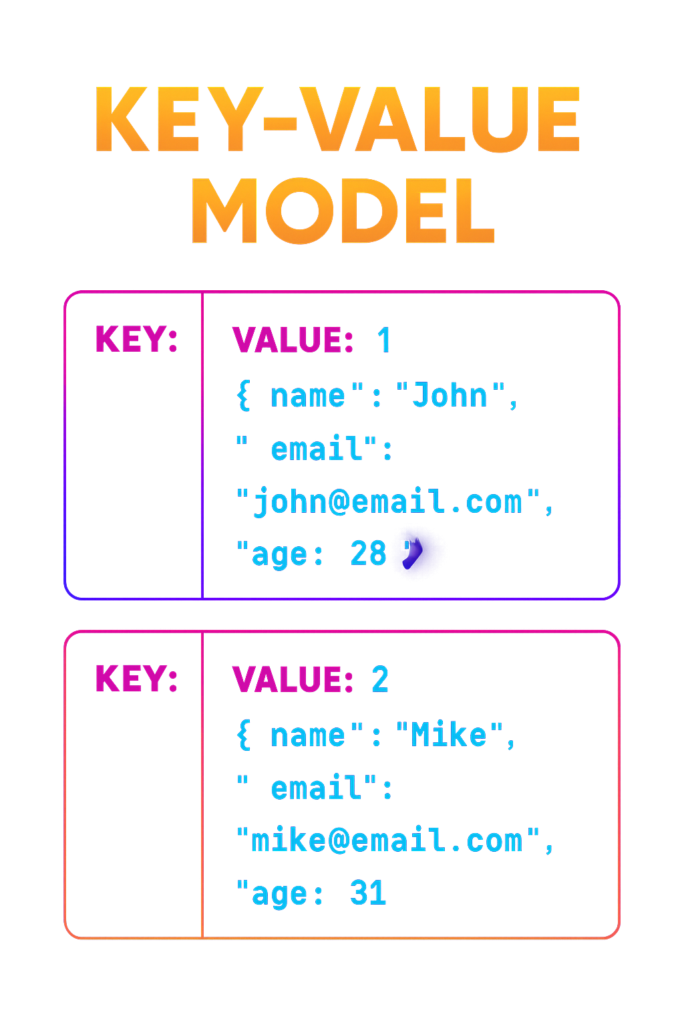
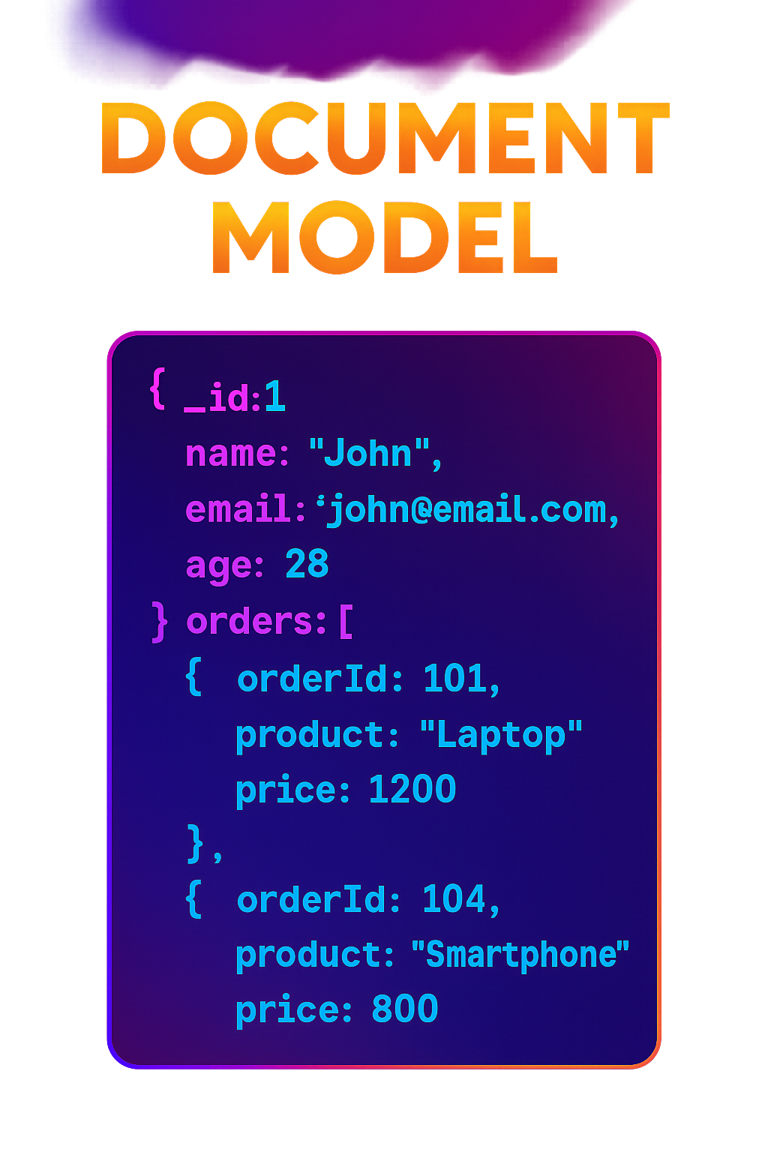
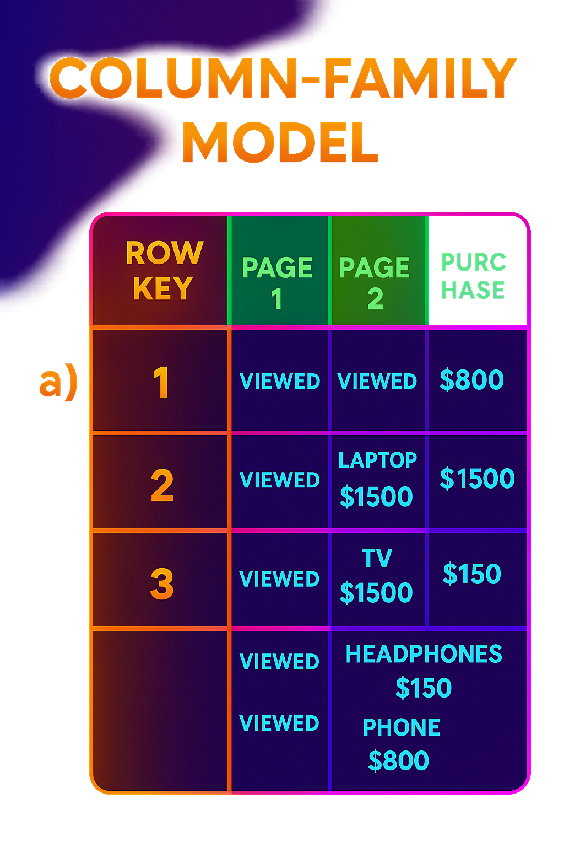
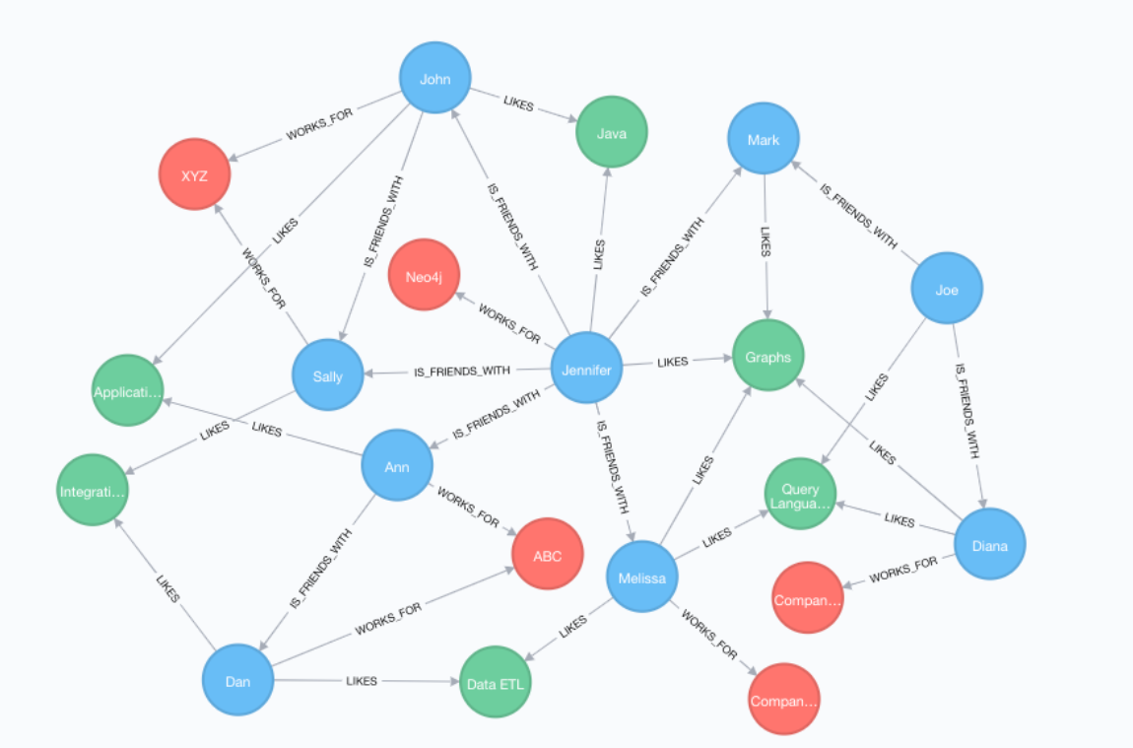
1. Data Model
The data model of a database defines how data is stored, organized, and related.
SQL (Relational Database)
Stores data in tables (rows & columns).
Uses primary keys (unique ID) and foreign keys (relationships).
Great for structured data and complex queries.
NoSQL (Non-Relational Database)
supports flexible data formats. Multiple types:
a) Key-Value Store (e.g., Redis)
Simple: like a dictionary.
Fast lookups using a key.
b) Document Store (e.g., MongoDB)
Stores JSON-like documents.
Flexible structure, can nest data.
c) Column Store (e.g., Cassandra)
Data is in rows with dynamic columns.
High performance for large datasets.
d) Graph DB (e.g., Neo4j)
Data is stored as nodes (data) and edges (relationships).
Best for complex relationships like social networks.

Slide 3
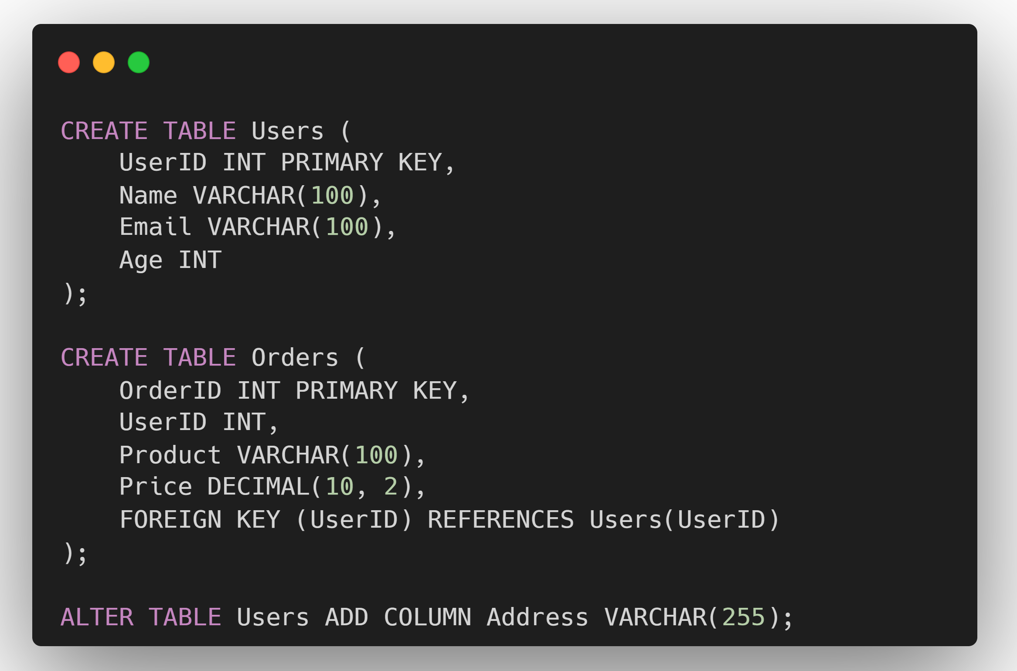
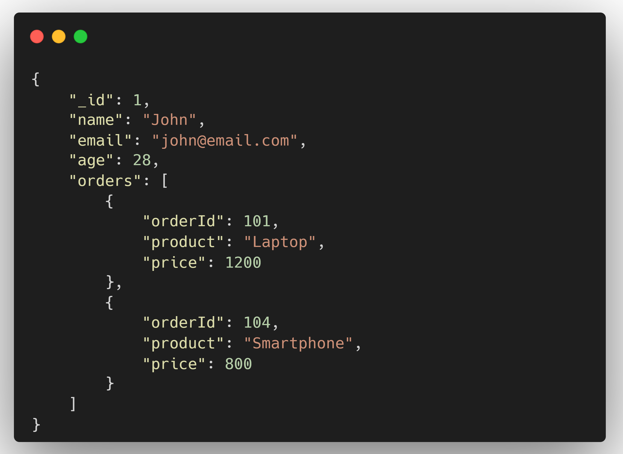
2. Schema
SQL (Relational Database)
In SQL databases, the schema must be defined upfront before inserting any data.
Each table has a specific set of columns with defined data types, constraints, and relationships. The database enforces this schema, ensuring that every row adheres to the predefined structure.
This schema enforcement ensures data integrity, making SQL databases ideal for applications where consistency and accuracy are critical.
NoSQL (Non-Relational Database)
In NoSQL databases, there is no fixed schema that must be defined upfront.
This allows for flexible and dynamic data structures, where different records can have different attributes.
This flexibility makes NoSQL databases suitable for applications where data formats may evolve over time.
In NoSQL databases, schema changes are much simpler because the schema is dynamic. You can add new fields to individual records without affecting other records or requiring a schema migration.

Slide 4
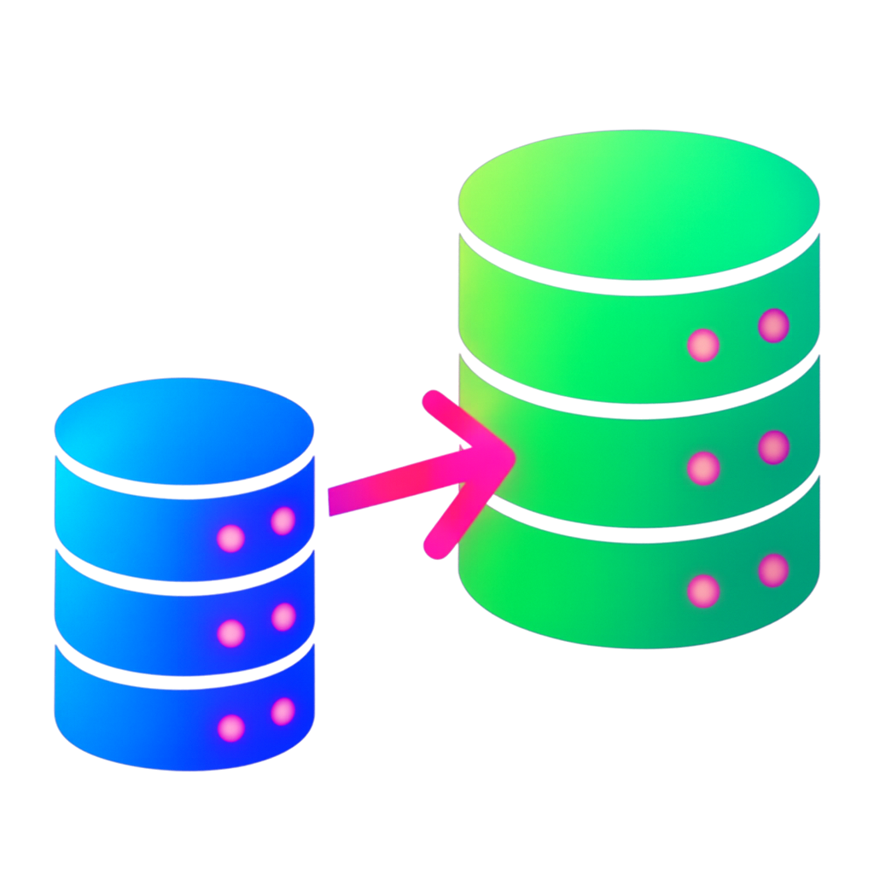
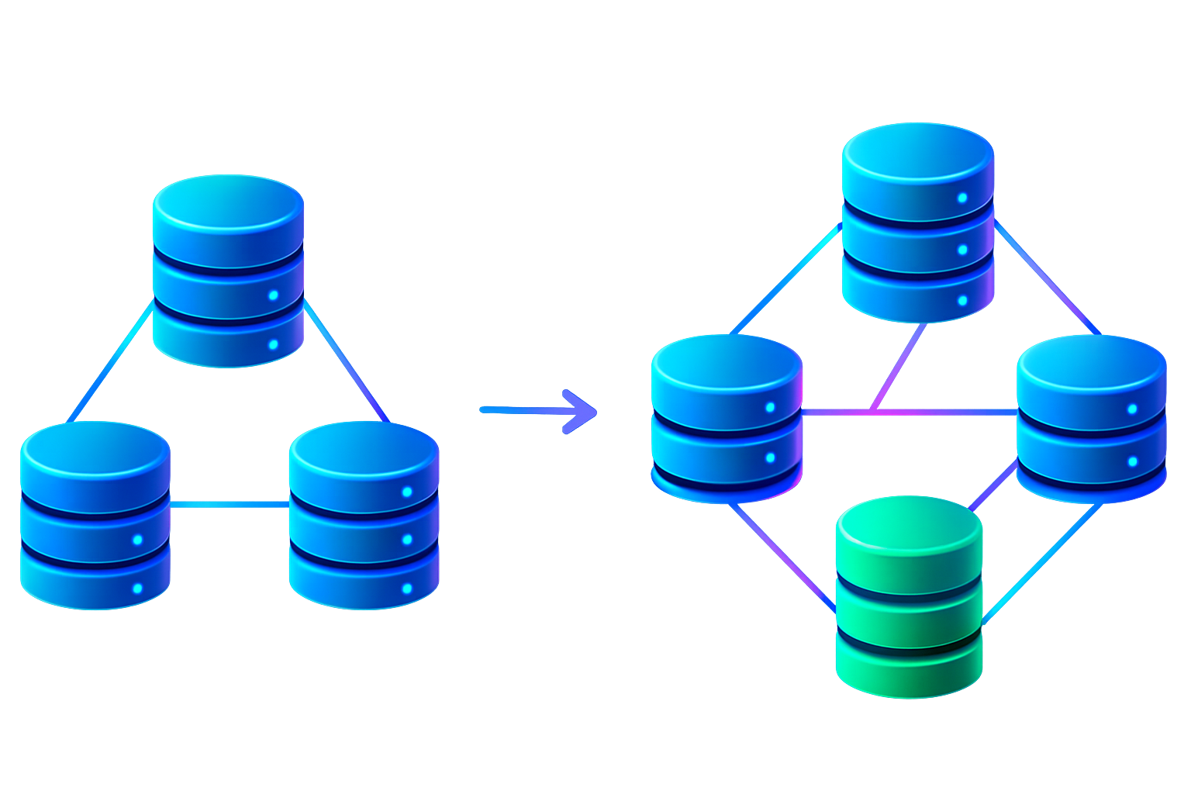
3. Scalability
SQL (Relational Database)
SQL databases are typically designed to scale vertically (also known as scale-up).
This means improving performance and capacity by adding more power (e.g., CPU, RAM, or storage) to a single server.
This approach works well for moderate loads but becomes limiting when the application scales to high levels of traffic or data growth.
NoSQL (Non-Relational Database)
NoSQL databases are designed to scale horizontally (also known as scale-out).
This means increasing capacity by adding more servers or nodes to a distributed system.
This distributed architecture allows NoSQL databases to handle massive volumes of data and high traffic loads more efficiently.
Each node handles a portion of the data, allowing for better load distribution and fault tolerance.

Slide 5
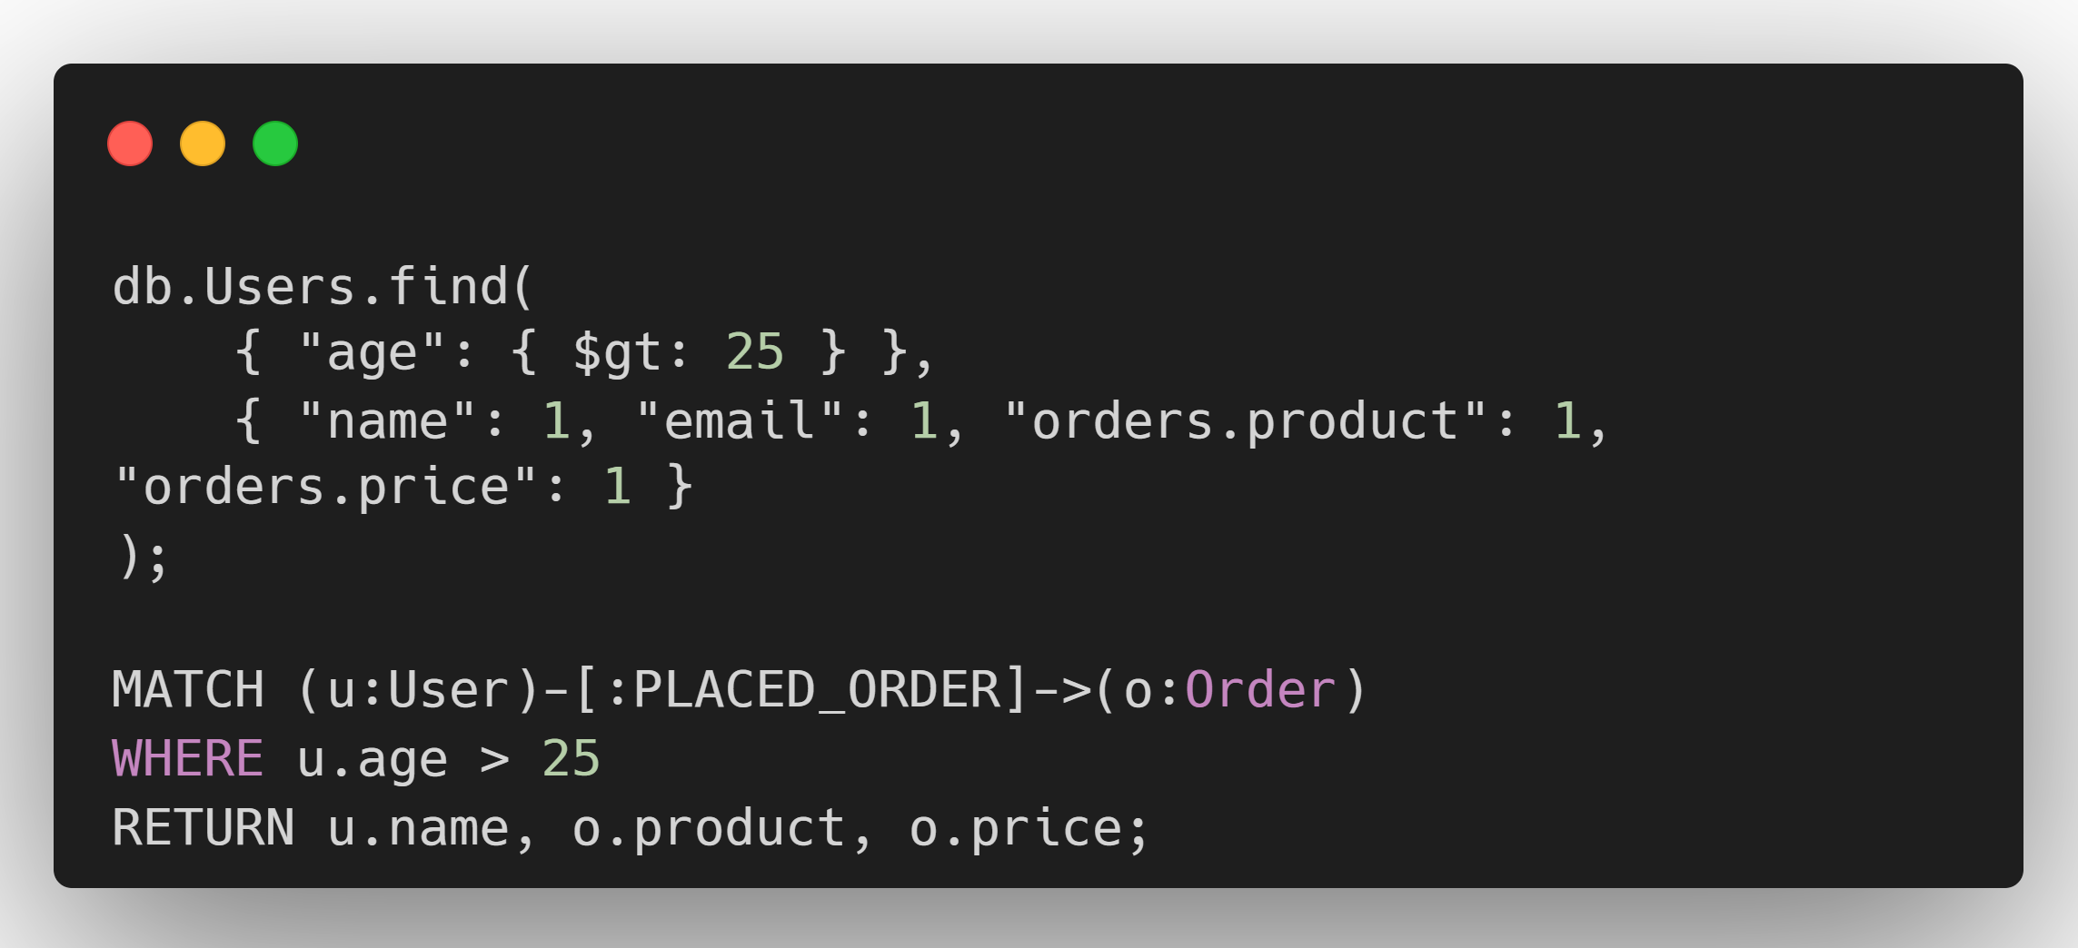
4. Query Language
One of the most significant differences between SQL and NoSQL databases is the query language used to interact with the data.
SQL (Relational Database)
SQL (Structured Query Language) is the de facto standard language used to interact with relational databases to perform operations such as data retrieval, insertion, update, and deletion.
It is declarative, meaning you specify what data you want, and the database engine determines how to retrieve it.
NoSQL (Non-Relational Database)
NoSQL databases do not have a standard query language. Each NoSQL database may have its query syntax or API, depending on its data model.
While this can provide more flexibility, it also means a steeper learning curve and potential limitations in querying capabilities.

Slide 6

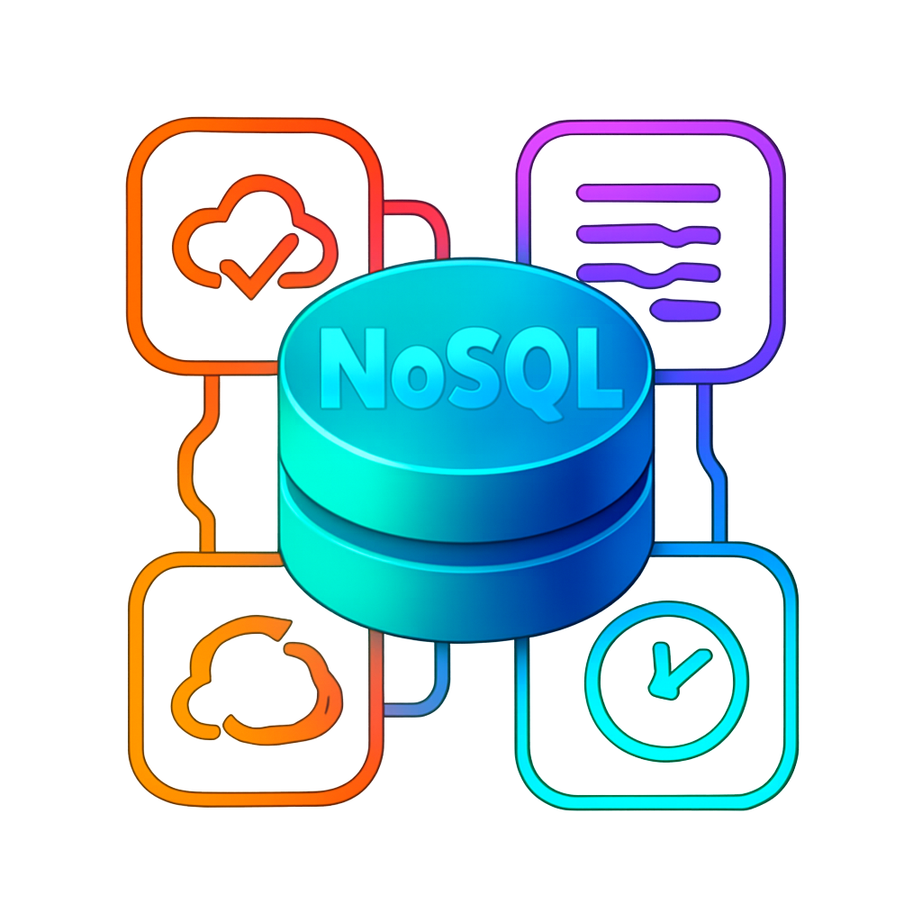
5. Transaction Support
Transactions in databases ensure that a series of operations are executed in a reliable, consistent manner.
SQL (Relational Database)
SQL databases are known for their robust support of ACID transactions.
Atomicity
Consistency
Isolation
Durability
NoSQL (Non-Relational Database)
NoSQL databases typically do not prioritize full ACID transactions due to the need for high availability and scalability in distributed environments.
Instead, many NoSQL databases follow the BASE model:
Basically Available
Soft state
Eventually consistent

Slide 7

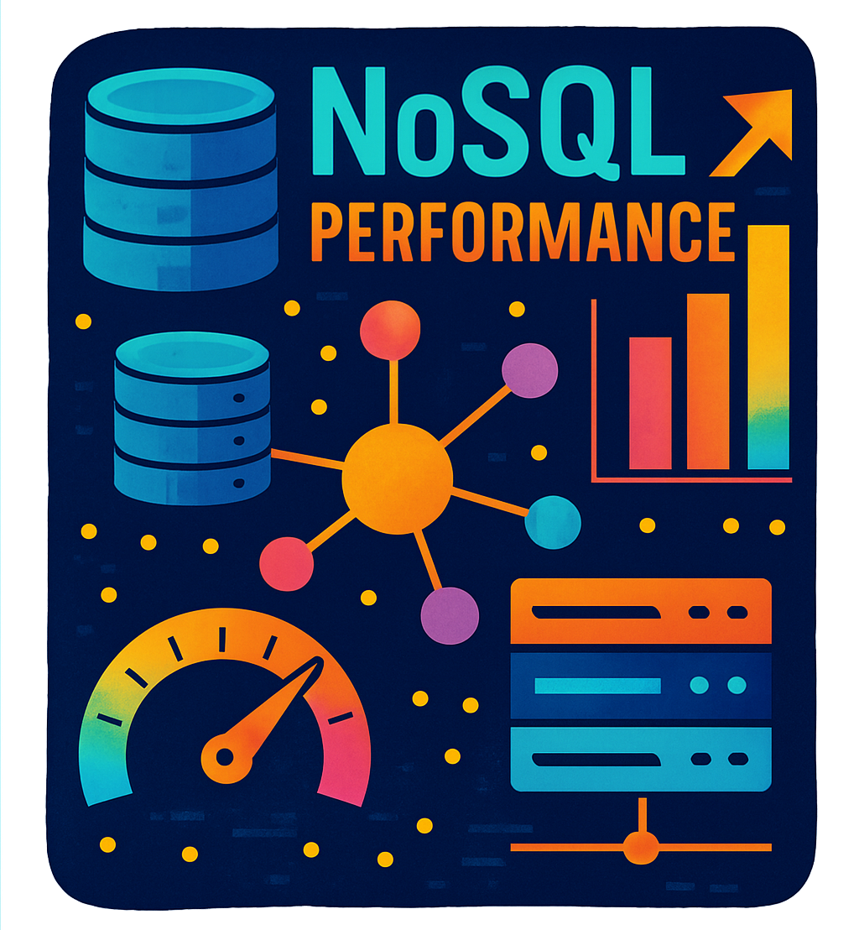
6. Performance
SQL (Relational Database)
SQL databases are optimized to handle complex queries involving multiple joins, aggregations, and transactions.
For small datasets, SQL databases perform well, as the query optimizer can efficiently execute joins and filter data.
As the dataset grows, performance may degrade due to the complexity of joining large tables, especially if indexing is not optimized.
Their performance can be excellent for read-heavy applications with well-defined schemas and where data integrity is paramount.
NoSQL (Non-Relational Database)
NoSQL databases are optimized to offer high performance at scale, especially for large volumes of unstructured or semi-structured data.
They prioritize horizontal scalability and are optimized for high-throughput read/write operations, making them ideal for real-time applications, big data, and large-scale distributed systems.

Slide 8
7. Use Cases
The choice between SQL and NoSQL databases often depends on the specific use case, as each type of database excels in different scenarios.
SQL (Relational Database)
SQL databases are ideal for applications that require:
Structured data with predefined schemas.
Complex queries involving joins, aggregations, and transactions.
Strong consistency and ACID (Atomicity, Consistency, Isolation, Durability) properties.
Relational data where relationships between tables are important.
They are commonly used in industries like finance, healthcare, and government, where data integrity and relational structures are paramount.
NoSQL (Non-Relational Database)
NoSQL databases are ideal for use cases requiring:
Horizontal scalability to handle large amounts of distributed data.
High-performance reads and writes for real-time applications.
Flexible schema to store unstructured or semi-structured data.
Eventual consistency and high availability in distributed systems.
They are popular in industries like social media, IoT, and big data analytics, where flexibility and scalability are more important than strict consistency.

Slide 9
